Slide 1
PROTOCOLS AND TCP/IP PROTOCOL SUITE
Introduction to Network Security & Firewalls
By
Dr.Col Joseph Kalunga (Ph.D)

Slide 2

Protocols and the TCP/IP Protocol Suite

Slide 3
Content
History
TCP/IP Suite Layer
a} Network Interface
b} Internet Layer
c} Transport Layer
d} Application Layer
3.Comparison of OSI and IP

Slide 4
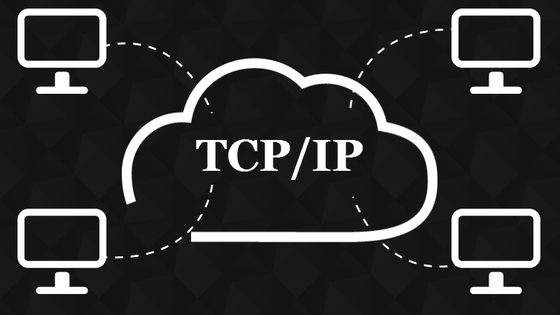
History Of TCP/IP Suite
The Transmission Control Protocol/ Internet Protocol suite of protocol form the basis of the internet. It is TCP/IP that creates a virtual network when multiple computer networks are connected together. The TCP/IP networks was earlier known as ARPANET, but is now known as internet.

Slide 5
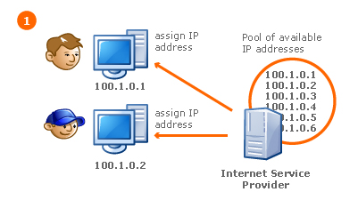
What is IP, Protocol?
Protocol: -
In information technology, a protocol is the special set of rules that end points in a telecommunication connection use when they communicate. Protocols specify interactions between the communicating entities.
IP: -
An Internet Protocol address (IP address) is a numerical label assigned to each device (e.g., computer, printer) participating in a computer network that uses the Internet Protocol for communication.

Slide 6
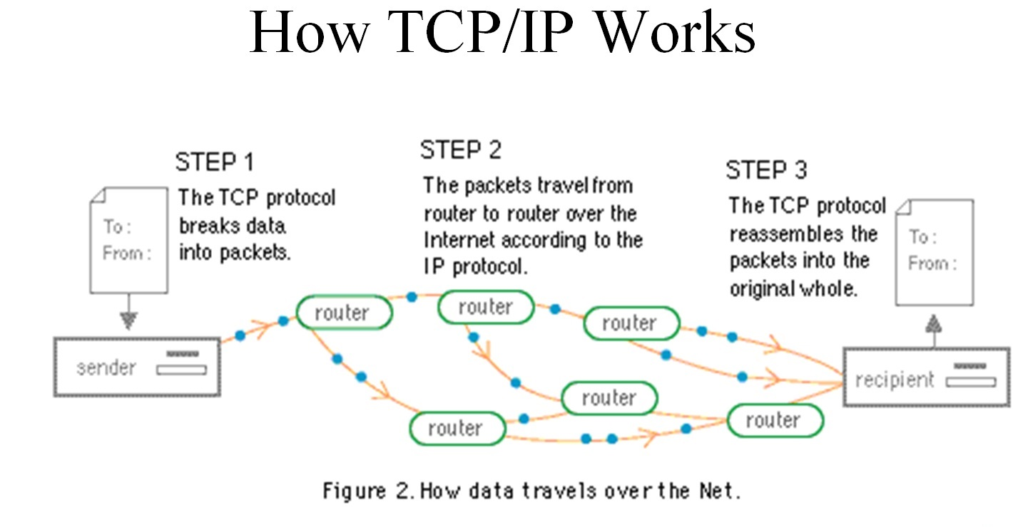
Working Of TCP/IP

Slide 7
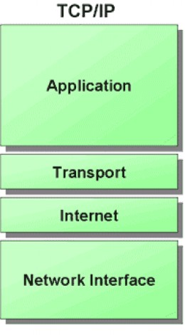
TCP/IP Suite layer
TCP/IP Suite consists of Four layer
Network Interface: - It include the function of physical layer and data link layer.
TCP/IP protocol suite includes Host-to-network layer protocols such as Serial Line internet protocol and point to point protocol
Internet Layer: - The internet layer is exactly same to the network layer of OSI model.
IP is the primary protocol operating at this layer and it provides data encapsulation ,routing, addressing and fragmentation services to the protocols at the transport layer above it.

Slide 8
TCP/IP Suite layer
Transport Layer: - TCP/IP Suite includes two protocol at this layer, the transmission control protocol and the user datagram protocol
These protocol provides connection or connectionless data transfer services.
Application layer: - The TCP/IP protocol at the application layer can take different forms of Protocols, such as the File Transfer Protocol, Hypertext Transfer Protocol.

Slide 9
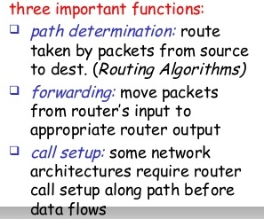
Network Interface Layer
It is the bottom layer of TCP/IP Model lies below the Internet Layer.
It is also known as Host To Network Layer
Function of this layer is to connect the Host To Network & inform the upper layers so that they could start sending the data packets.
This layer varies from network to network.
Host To Network Layer protocols
SLIP(Serial Line IP )
PPP( Point To Point Protocol )

Slide 10
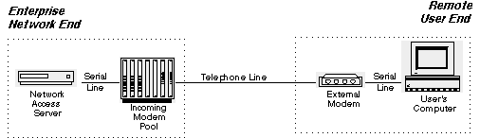
Serial Line Internet Protocol
Serial line Internet protocol is very simple and used to connect the workstation to internet over dial-up line using a modem.
SLIP(Serial line Internet protocol ) is not a standard protocol for carrying IP Packets over the a serial line between a home user and The ISP server. But , it has become popular because of its simplicity .
The role of SLIP begins only when there is a proper connection between the two modem.

Slide 11
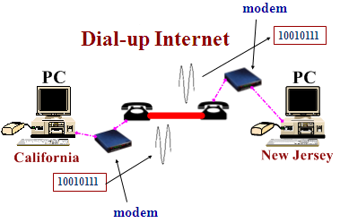
Problem with SLIP Protocol
It is not an approved internet standard.
It does not provide any authentication.
SLIP provides no way for the two devices to communicate control information between them to manage the link.
SLIP doesn't provide any way of detecting or correcting errors in transmissions.

Slide 12
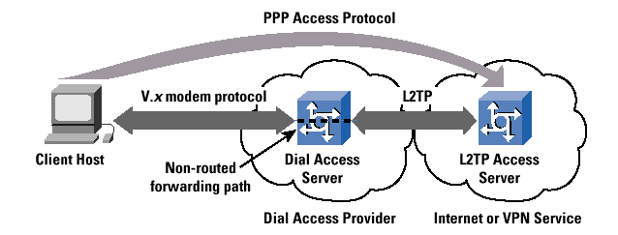
Point to Point Protocol ( PPP )
Point to Point Protocol is a data link layer Protocol.
PPP is another examples of the evolving the nature of internet.
It has become standard internet protocol for remote access, using dial-up connection.
The basic Functionality of PPP is similar to the SLIP.
It passes the and other packets in the form of frames between a client and ISP Server.
PPP is more complex than SLIP.

Slide 13
PPP Set of Protocol Are as given below:
Line control Protocol(LCP): - The Line control protocol is responsible for establishing , maintaining the connection between the Two end ( Home User and the ISP )
Password Authentication Protocol( PAP ) : - password authentication protocol is used.
Here the user must establish a proof of identity , so that he can connect to ISP.
Network Control protocol ( NCP ): - Once the Authentication is done, PPP on the client side sends out a NCP packet. This packet tells the ISP server what kind of traffic is to be passed over this PPP link.
IP Control Protocol ( IPCP ) : - the IP Control Protocol takes over. Here , actual IP packet are now exchanged. IPCP establishes the connection between the Host user and ISP.

Slide 14
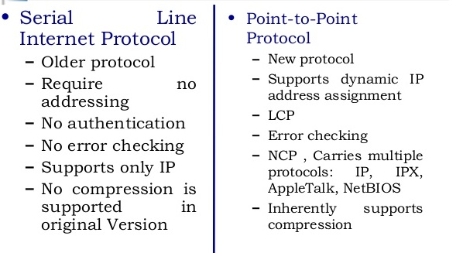
Comparison between The SLIP And PPP

Slide 15
Internet Layer
The fives network layer protocol are as follows:-
ARP
RARP
IP
ICMP
IGMP
IP is an Important protocol in this layer.
ARP ( Address resolution protocol )
Every machine on internet has one address, these address cannot actually be used for sending packets data because data link layer does not understand the internet address.
ARP Provides an essential services when TCP/IP is running in LAN.
IP Address
ARP
Physical Address

Slide 16
RARP ( Reverse Address Resolution Protocol )
The Reverse Address Resolution Protocol is used to obtain the IP address of a Host based on Its physical address. That is , it preform a job that is exactly opposite to that of ARP.
RARP works in a very similar way to ARP. but in the exactly opposite direction , as shown in the side figure.
Physical Address
RARP
Note: - IP Address is a universally unique address and inter-networked address.
MAC Address is local address. It is unique locally but not universally.
IP Address

Slide 17

Internet Protocol ( IP )
Internet Protocol is very important protocol present in this network layer.
IP is the protocol responsible for carrying data, generated by nearly all the other TCP/IP protocol, from the source system to its destination .
IP Features : -
Unreliable
IP is unreliable , it means that it does not provide a guarantee that a datagram send from a source computer definitely will arrive at the destination.
Connectionless
IP services is similar to the postal service.
It is possible that the order in which the message are sent and the order in which they are received is different.

Slide 18
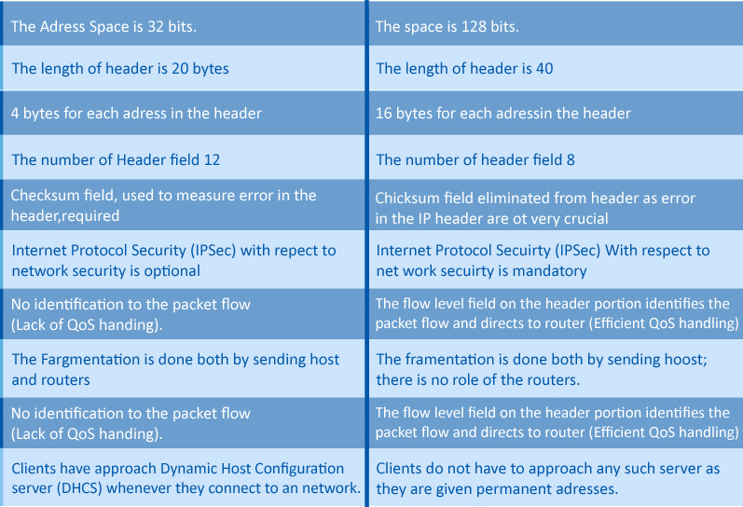
Difference Between IPv4 And IPv6
IPv4
IPv6

Slide 19
Transport Layer ( TCP and UDP )
The transport layer runs on the top of internet layer and is mainly concerned with transport of packets from the source to the destination.
The main function of transport layer is to deliver packets between the end points.
In TCP/IP, the transport layer include to protocols : TCP and UDP.
Transport Layer Protocols
Transmission control Protocol( TCP )
User datagram protocols ( USP )

Slide 20
Comparison between TCP And UDP
Parameter | UDP | TCP
Data Transfer | Data is sent in discrete packages by the application. | Data is sent by the application with no particular structure.
Transmission speed | Very High | High but not as high s UDP
Protocol connection setup | Connectionless | Connection oriented
Used | UDP is useful when speed of delivery is critical | TCP is useful for transmission of data without error.

Slide 21
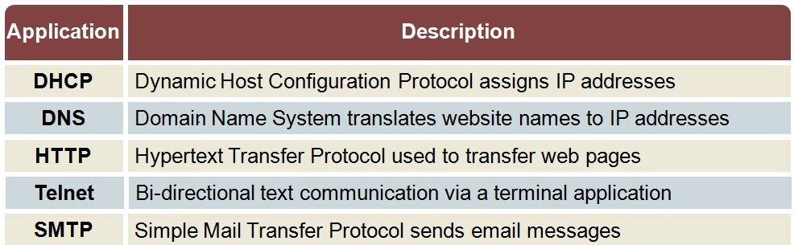
Application Layer
The TCP/IP Model Does Not have Session or presentation layer on the top of the transport layer.
It is just has the application layer. It contains all higher level protocols.
Higher Level Protocols Used in application layer are as Follows:

Slide 22

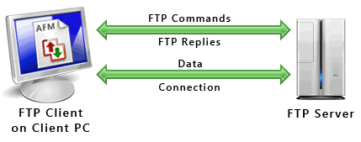

Types Of Protocol In application Layer
TELNET: - the virtual terminal protocol allows a user on one machine to log onto a distant machine and work there.
FTP: - File Transfer protocol provides a way to move data efficiently from one machine to another.
SMTP: - Simple mail transfer protocol developed for email transfer.
DNS: -Domain Name System Protocol is used for mapping the host names onto their network address.
HTTP: -hyper Text transfer Protocol is used for fetching pages on the world wide web (WWW) and many others.

Slide 23
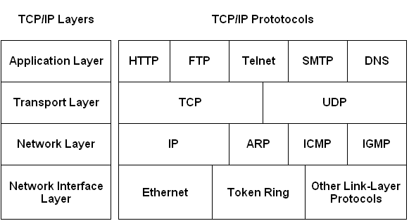
TCP/IP Reference Model

Slide 24
Comparison Of OSI and TCP/IP
OSI | TCP/IP
Its has seven Layer | Its has four layer
It Supports both connection oriented and connectionless communication. | Its support only connectionless communication.
Transport layer provides connection oriented communication. | Transport layer provides connection oriented communication and connectionless.
Transport layer guarantees delivery of packets | Transport layer does not guarantees delivery of packets
Application
Presentation
Session
Transport
Network
Data link
Physical
Application
Transport
Internet
Network Interface

Slide 25
END OF CHAPTER
Thank You

